Slide 1

Database Project Report ON AIRLINE TICKET RESERVATION MANAGEMENT SYSTEM
Team:
ADISH JAIN – 2010990028
AMIT GUPTA – 2010990060
ADITI MAINI – 2010990029
KARAN AHUJA - 2010990362

Slide 2
INDEX
Abstract
Acknowledgements
Chapter 1: Introduction
Name of Case Study
Case Study Informal Description
Terminologies and Symbols of E-R diagram
Case Study Logical Model(ER Diagram)
Case Study Physical Schema
Structure Of Case Study
Keys and Functional Dependencies
Case Study Interactive Queries
Normalisation
Conclusion
Bibliography

Slide 3
Introduction and project scope
We have planned to enhance an Airline Ticket Reservation. In our system, the customer can easily access the details and makes the icket reservation more simpler by removing the consistency.
A Database is a collection of well defined, inter-connected information about a particular enterprise.
A Database Management System (DBMS) is software designed to store, retrieve, define, and manage data in a database.
A Relational Database Management System (RDBMS or just RDB) is a common type of database that stores data in tables, so it can be used in relation to other stored datasets.

Slide 4
Entities
Admin entity will store the details of the Admin like their admin_ID, fname ,lname, age etc .
The Customer entity will store the details of Customer like cust_ID , fname , cust_email , cust_pass, etc.
A traveller schedules its journey with booking a flight. So the Schedule entity covers attributes like sched_ID, date_flight , date_flight, time_depart,time_land .
Ticket entity ensures customer’s ticket of that fight dealing with information in it like ticket_ID , ticket_num , date_avail, date_flight etc.
Reservation entity gives details of reservation to admin and customer containing attributes like res_ID,cus_ID,ticket_ID,etc.
Transaction entity gives details of booked ticket with Attributes like trans_ID,trans_name,trans_date etc.
Transaction_Type entity gives information about transaction of particular customer with their schedule . Attributes are transty_ID,ticket_ID,trans_name,etc.
Reports entity gives details about customer’s reporting date with Attributes like res_ID,report_ID,etc.

Slide 5
relations
Admin To Reservation: Admin manages all the reservation the basis of the information for the journey. The info of various flights available is stored in Reports table .The relation name is ‘Manages’.
Reservation to Transaction_Type: .After approving transaction with all details the control goes from transaction_type to Reservation for final reservation of tickets. The relation name is ‘Approves’
Reservation to Reports:. After reservation of ticket the information goes to Reports table for final report of Flight with its passengers. The relation name is ‘Reservation Report’.
Transaction to Reports: After transaction of money the information goes to Reports table for final report of Flight with its passengers. The relation name is ‘Provides Transaction Details’.
Transaction_Type to Transaction: After selection transaction type the information goes to transaction table for further procedure. The relation name is ‘Uses’.
Transaction to Schedule: After completing transaction the information goes to Schedule table for Scheduling the flight. The relation name is ‘Schedules’.

Slide 6
Functional dependencies
The functional dependency is a relationship that exists between two attributes. The left side of FD is known as a determinant, the right side of the production is known as a dependent.
Admin : admin_ID ,admin_pass → fname,lname,gender,age , admin_ID → contact_email
Customer : cust_ID,cust_pass → fname,lname,gender,age,contact_add,cust_email , cust_ID → contact_add,cust_email
Report : report_ID → res_ID,trans_ID,report_date , res_ID → report_date
Reservation: admin_ID → res_ID,cust_ID,ticket_ID,date_res,date_accom ,
res_ID →res_ID,cust_ID,ticket_ID,date_reserve,date_accom , cust_ID -> ticket_ID
Schedule : sched_ID → date_flight,time_depart,time_land
Ticket : ticket_ID → ticket_num , ticket_num ->date_avail,date_flight,time_depart,time_land,destination
Transaction : trans_ID → cust_ID
Transaction_Type: ticket_ID → transty_ID , transty_ID → trans_name , sched_ID → ticket_ID

Slide 7
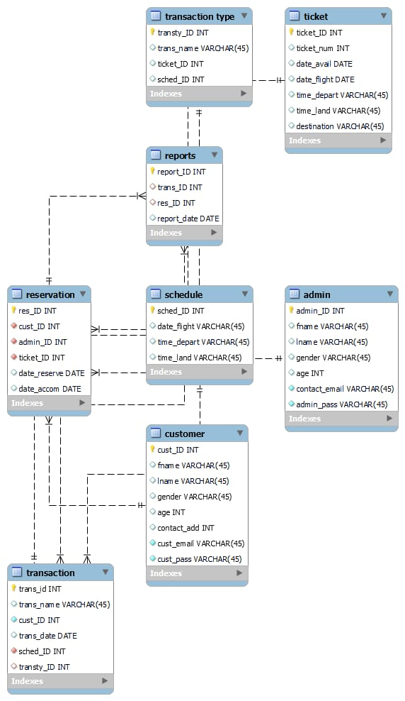
Er diagram

Slide 8
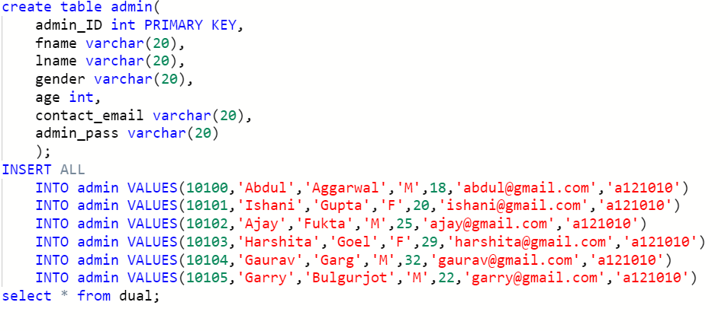
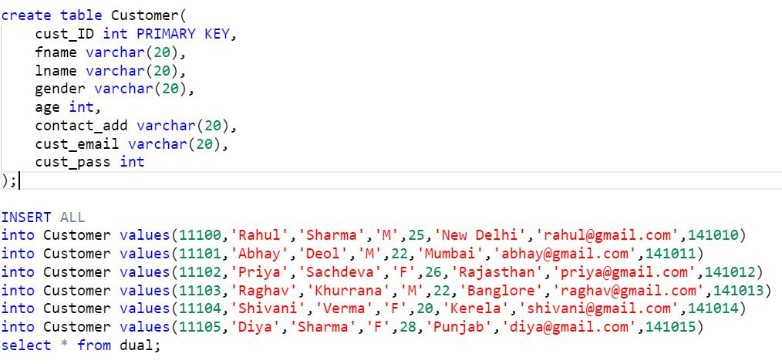
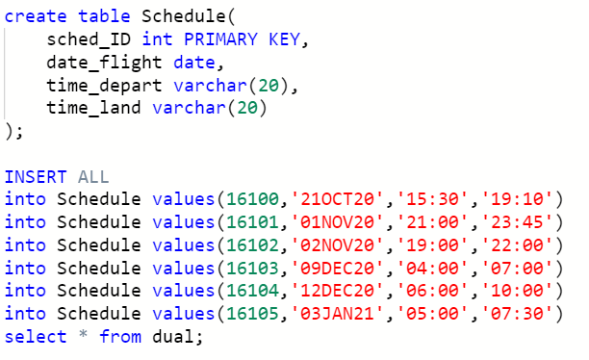
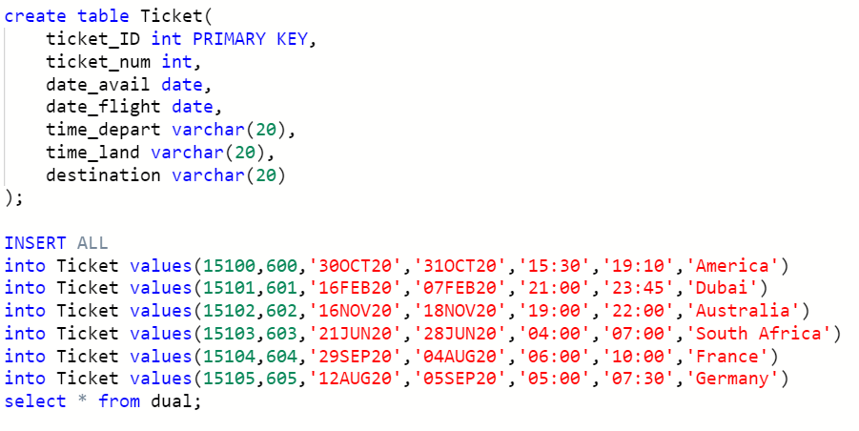
Creating TABLES and InsertiNG VALUES

Slide 9
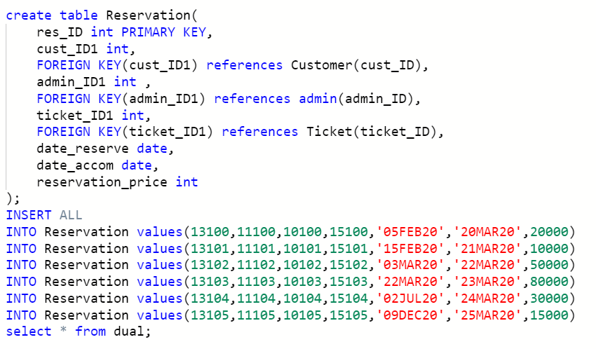
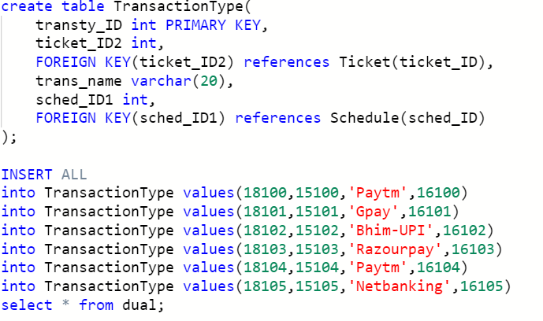
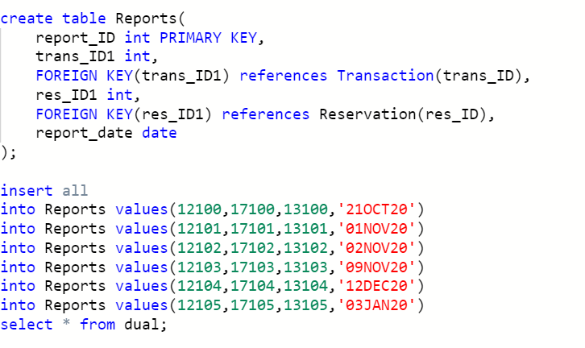

Slide 10

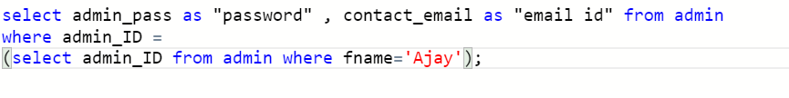
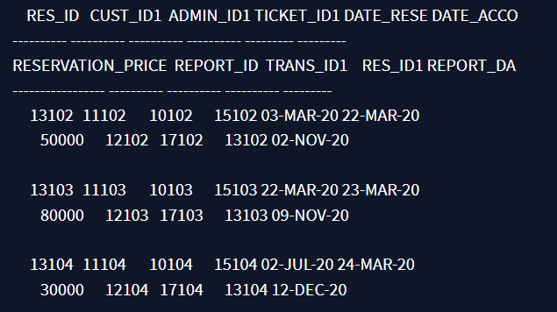
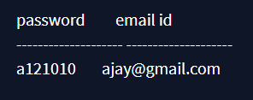
Sql queries
QUERY1:
To get the report where reservation price is greater than 20000
QUERY 2:
To get the email id and password of admin Ajay
OUTPUT:
Output:

Slide 11
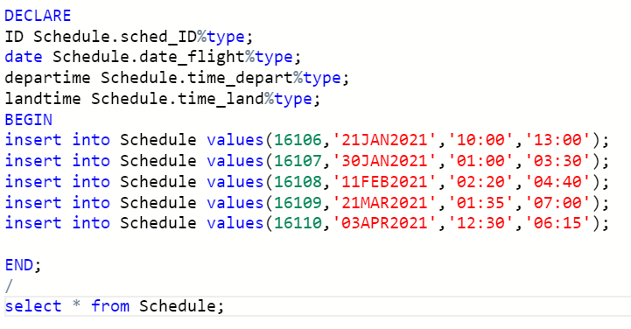
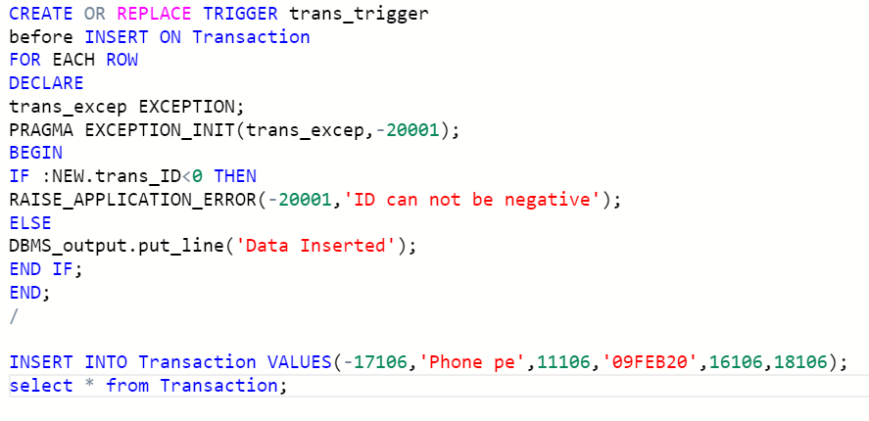

QUERY 4:
To create a trigger for transaction table where trans_ID can’t be negative
QUERY 5:
To get trans_ID from where transaction name are equal in both transaction table and transaction type table
QUERY 3:
To insert more flight schedule using PL/SQL queries in Schedule table.
Query 6:
To get reservation price from transactions made
QUERY 8:
To select admin_ID of the admin that manages the customer with age above 20
QUERY 7:
To fetch reports where reservation price is less than 20000
Query 9:
To get a view from Customer table where their age would be more than 25
Query 10:
To get admin age where age of admin is greater than 20

Slide 12
Conclusion & FUTURE WORK
We are trying to give a live reporting which is updated by Airline Companies so that customer gets a live Flights checking, Available seats, also planning to provide seats as per theirs choice so that they can travel very comfortably their journey. We will be trying to provide food facility and choice to customers so that they can feel like their home and more effective amenities. We are also trying to make more attention on Business class people and their requirements. Our future planning is to take this project towards an Android App and QR Code Scanning. So that a Customer can easily contact to the Airlines and they are getting quick Services from Airlines. We also want in future to place in market so that customer can take more advantages and saves their important time. We are also finding and approaching to companies which are using this type of software.

Slide 13
bibliography
https://www.lucidchart.com/
https://codequotient.com/code
https://www.flightslogic.com/airline-ticket-reservation-system.php

